Slide 1


Google Machine Learning courses
Notes:
https://developers.google.com/machine-learning/crash-course

Slide 2
What you will learn
Linear Regression
Logistic Regression
Classification
Working with Numerical Data
Working with Categorical Data
Datasets, Generalization, and Overfitting
Neural Networks
Embeddings
Large Language Models
Production ML Systems
AutoML
ML Fairness

Slide 3
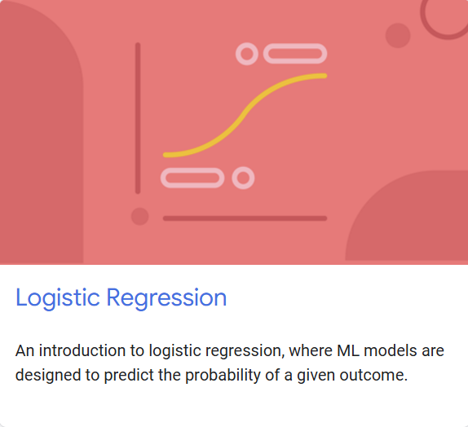
Logistic regression
Notes:
https://developers.google.com/machine-learning/crash-course/linear-regression

Slide 4
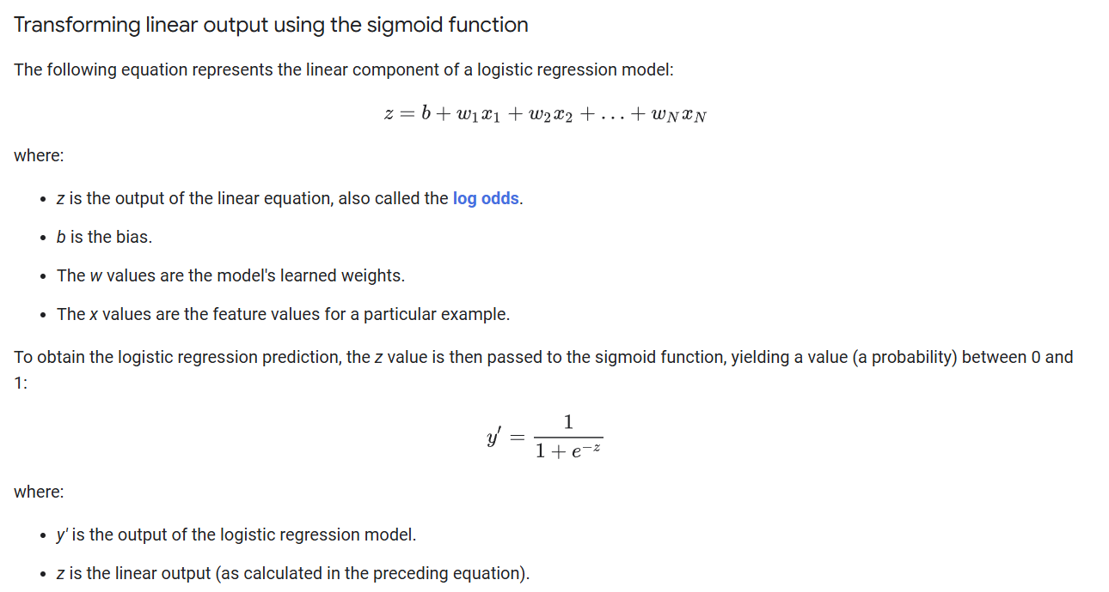

Slide 5
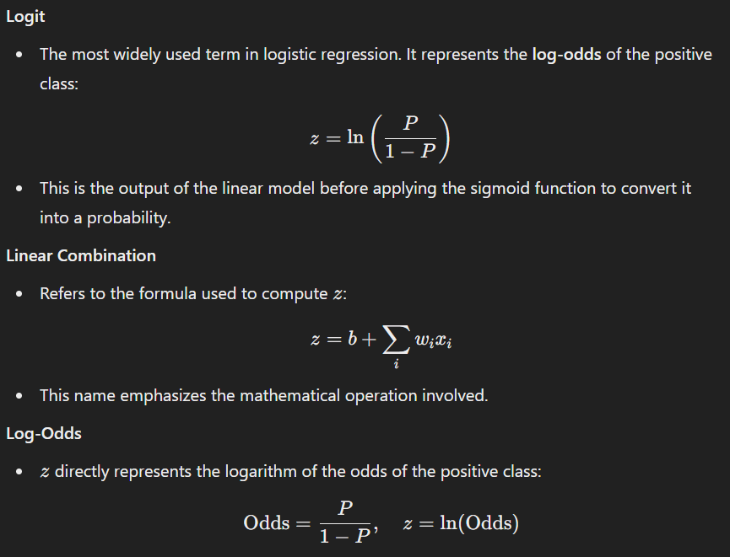

Slide 6
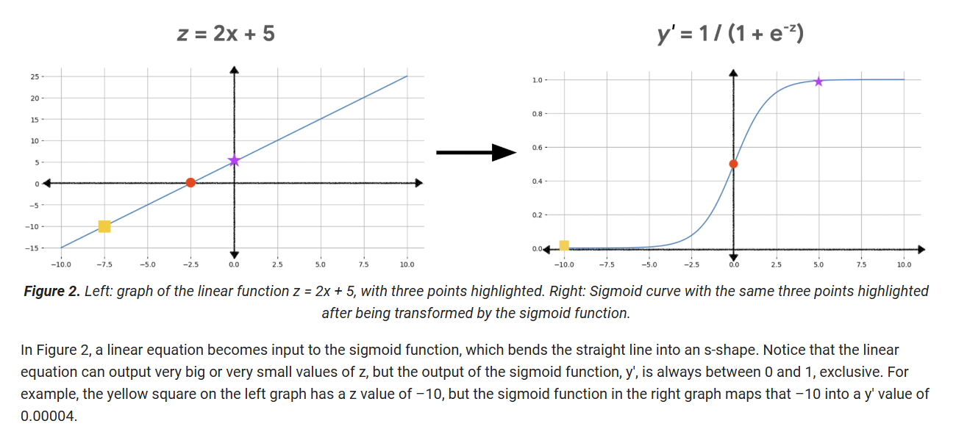

Slide 7
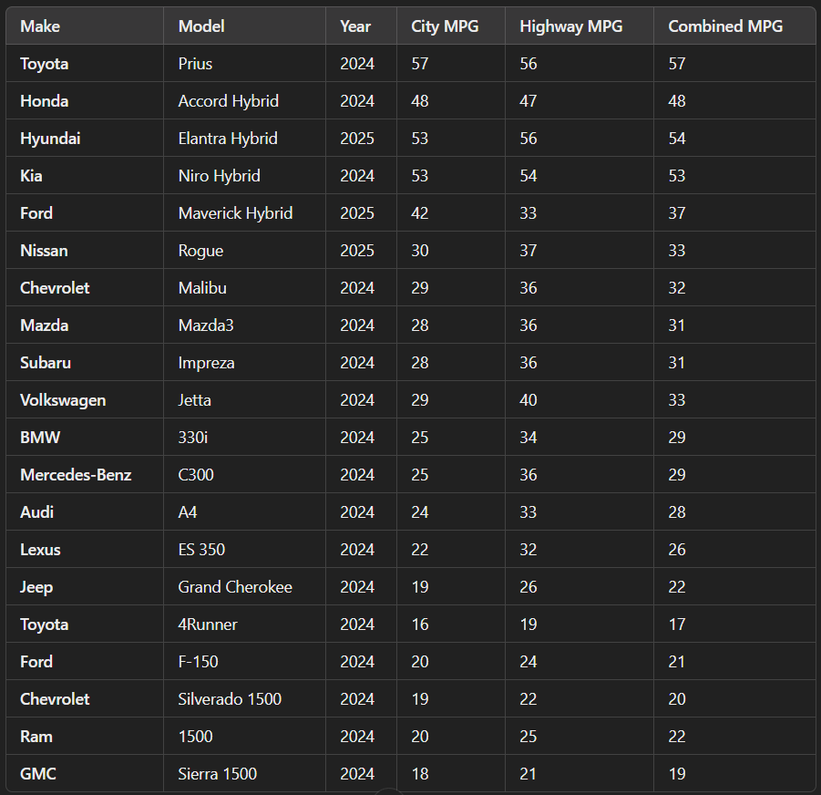

Slide 8
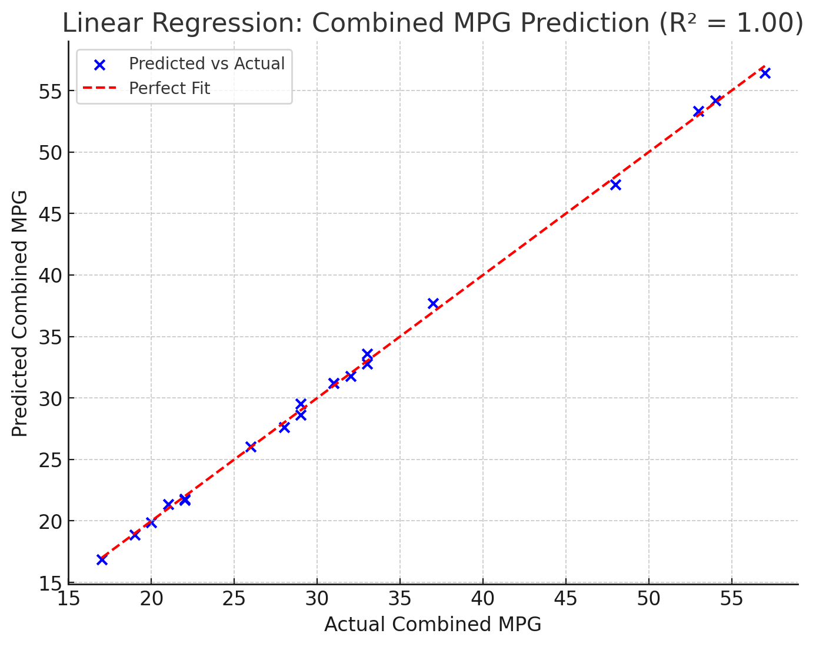

Slide 9
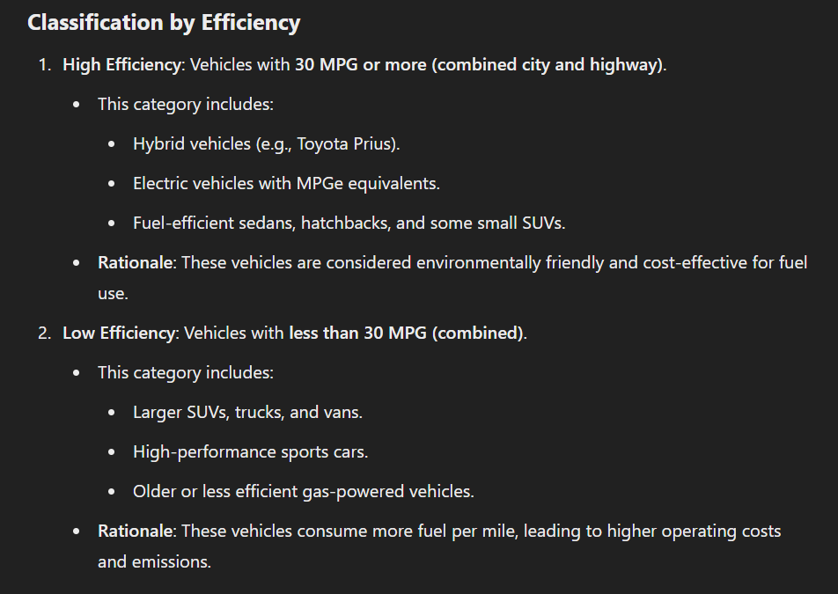

Slide 10
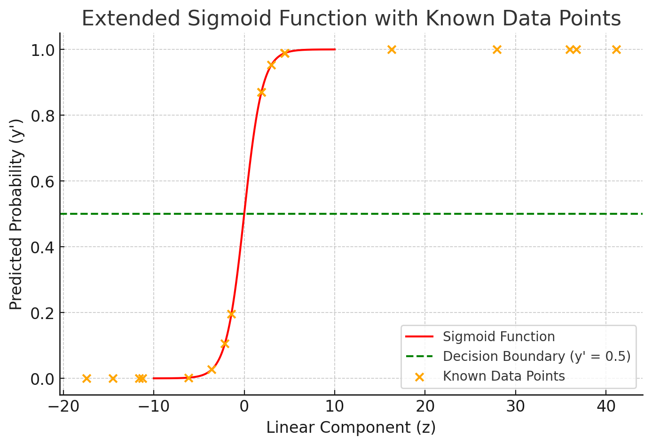

Slide 11
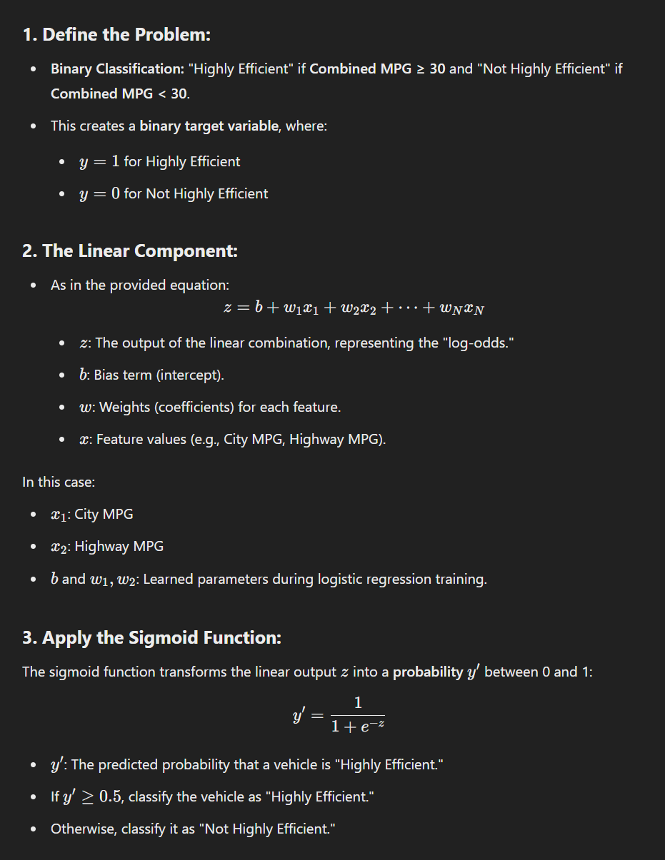

Slide 12
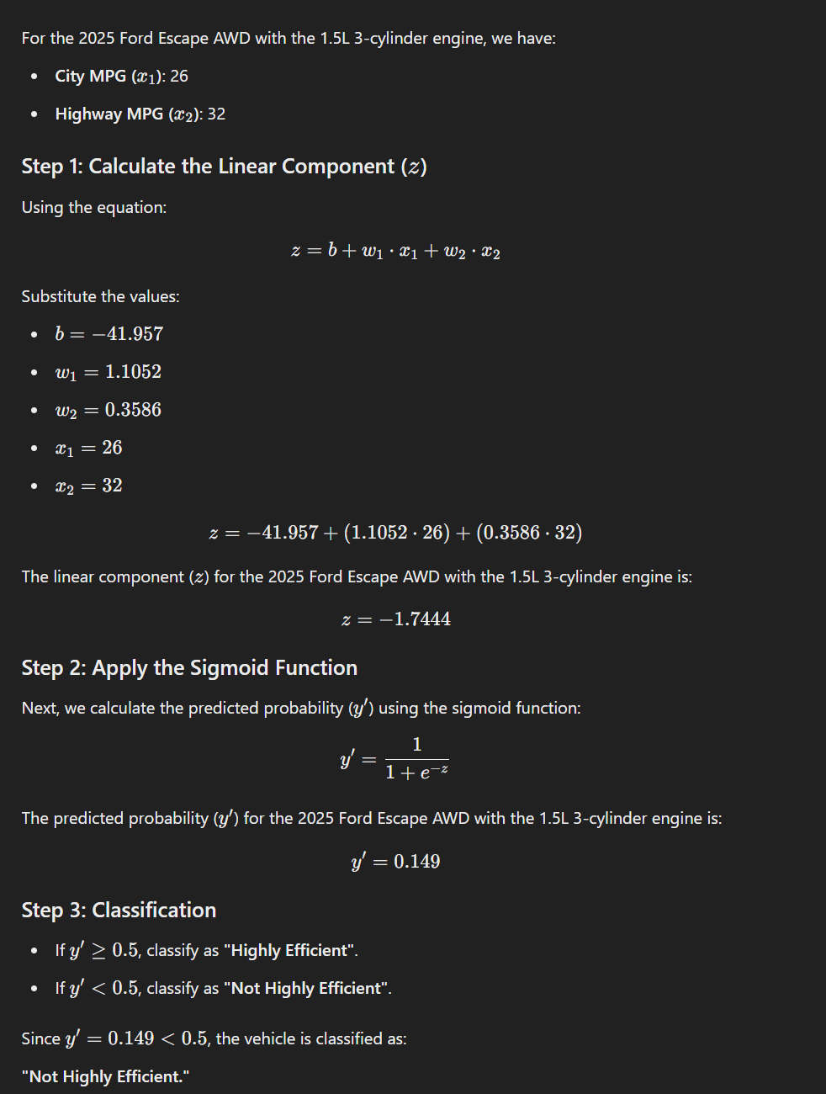

Slide 13
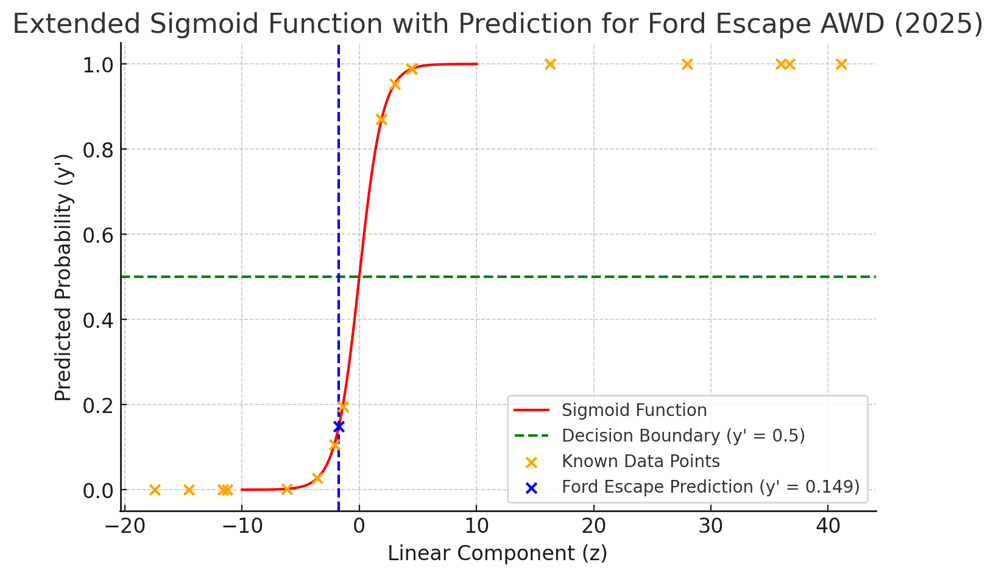

Slide 14
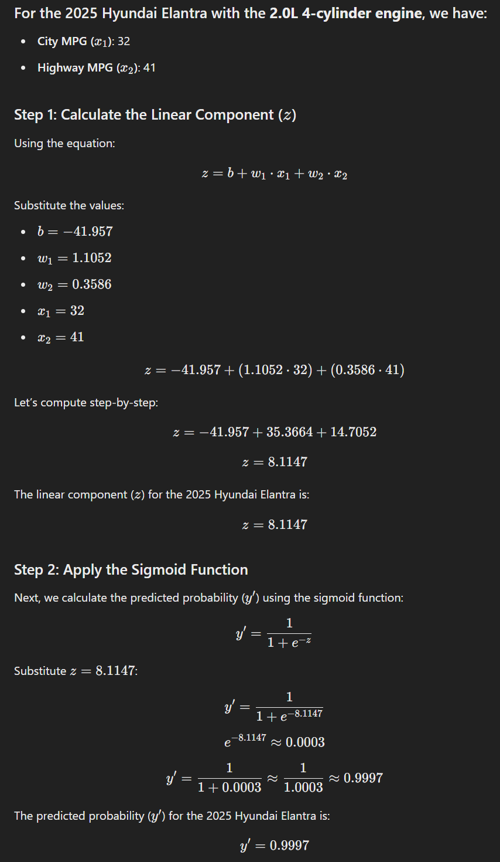

Slide 15
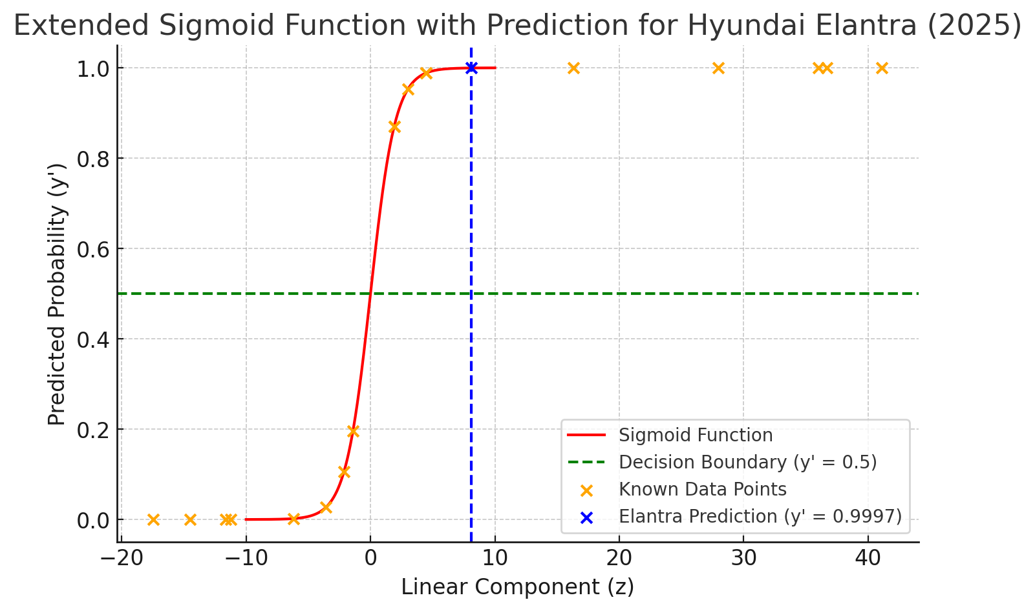

Slide 16




Notes:
https://www.youtube.com/channel/UC35ZpwldGw7ZJ5R-2sLijzw

Slide 17
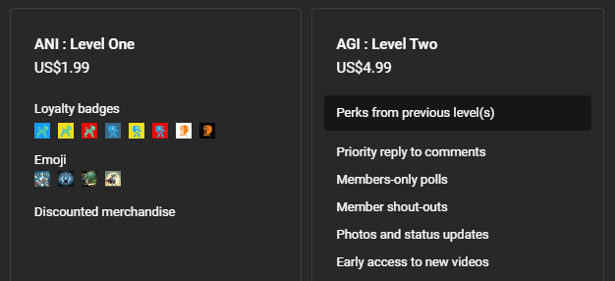
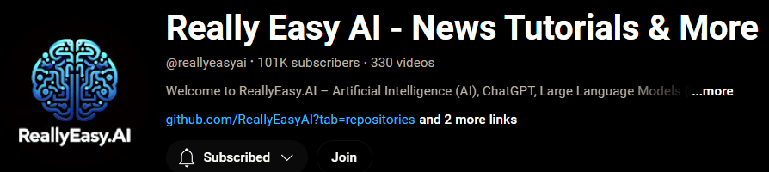
Membership has its privileges
Notes:
https://www.youtube.com/channel/UC35ZpwldGw7ZJ5R-2sLijzw/join

Slide 18

https://www.youtube.com/@AINewsFresh

Slide 19

https://www.youtube.com/@DailyAINewsPodcast

Slide 20

https://www.youtube.com/@AIPapersPodcastDaily

Slide 21
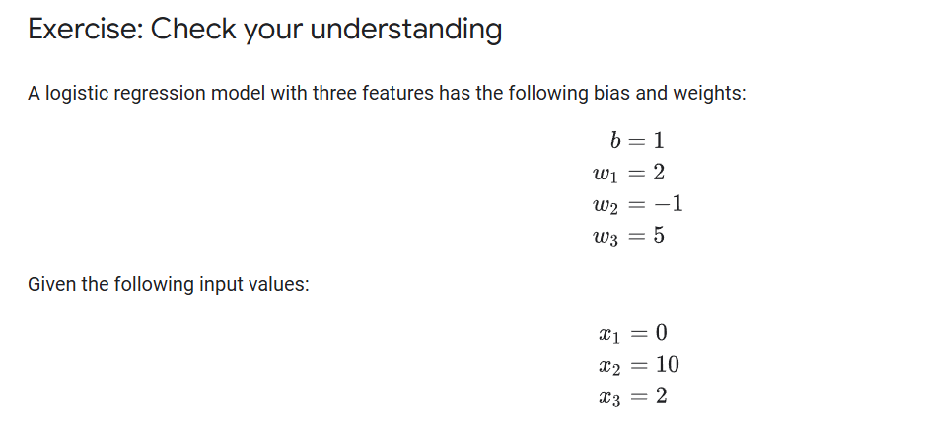

Slide 22
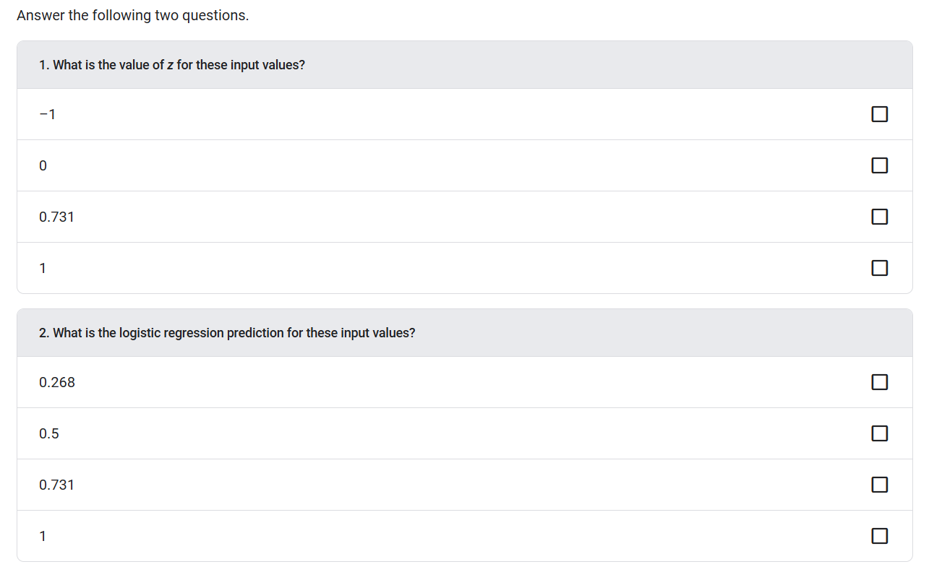

Slide 23
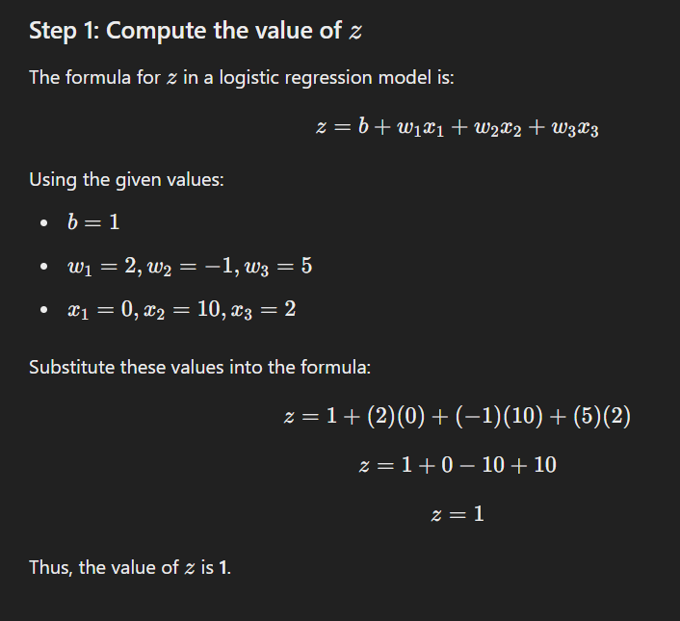

Slide 24
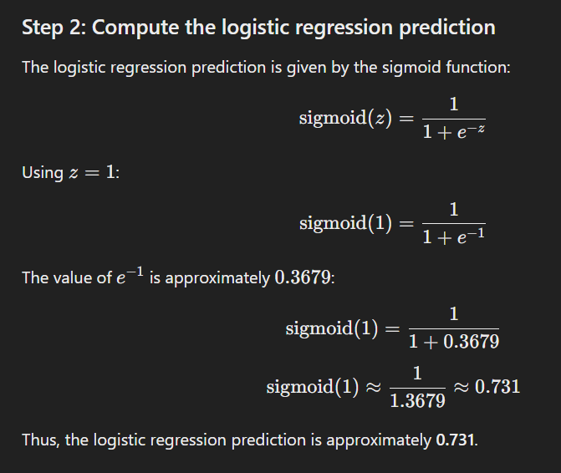

Slide 25
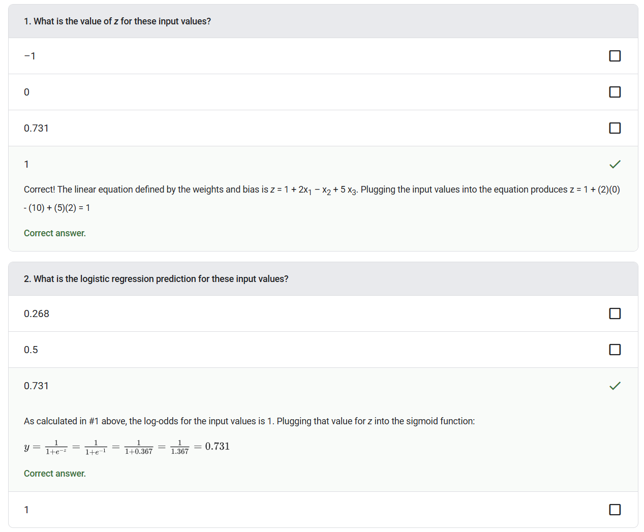

Slide 26
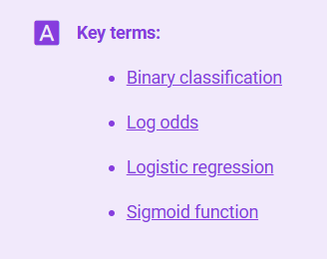
Notes:
https://developers.google.com/machine-learning/glossary

Slide 27
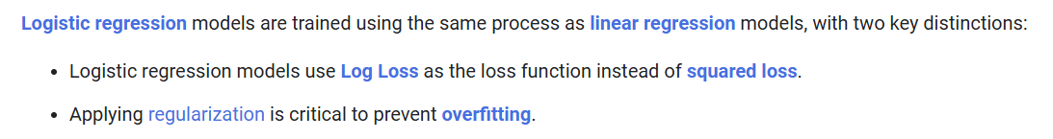

Slide 28
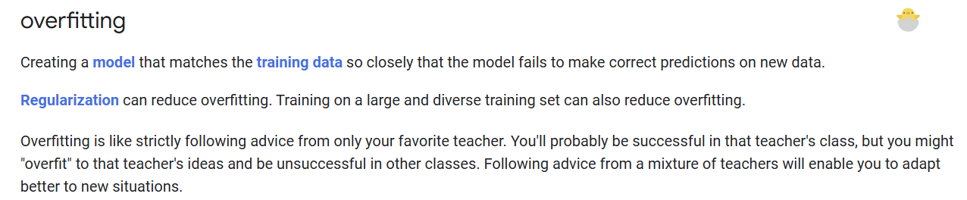

Slide 29
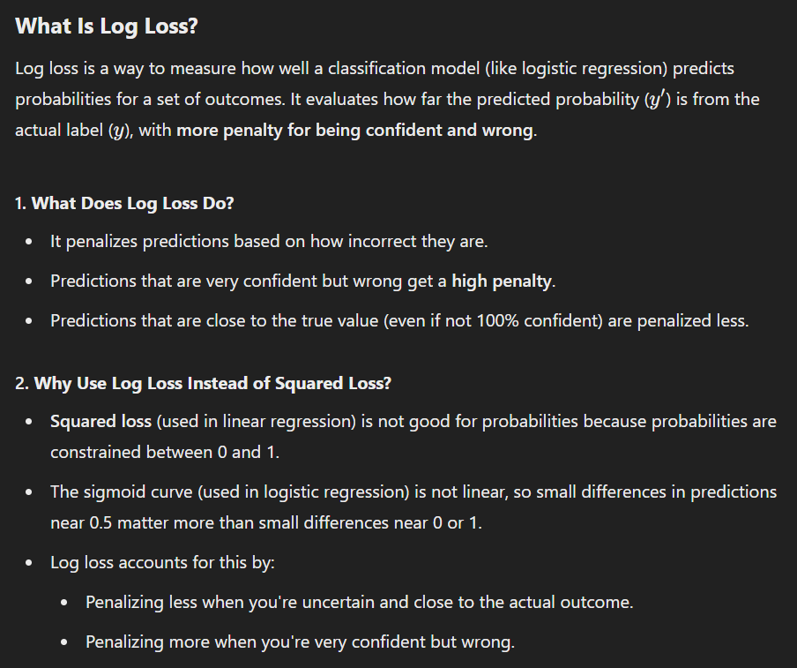

Slide 30
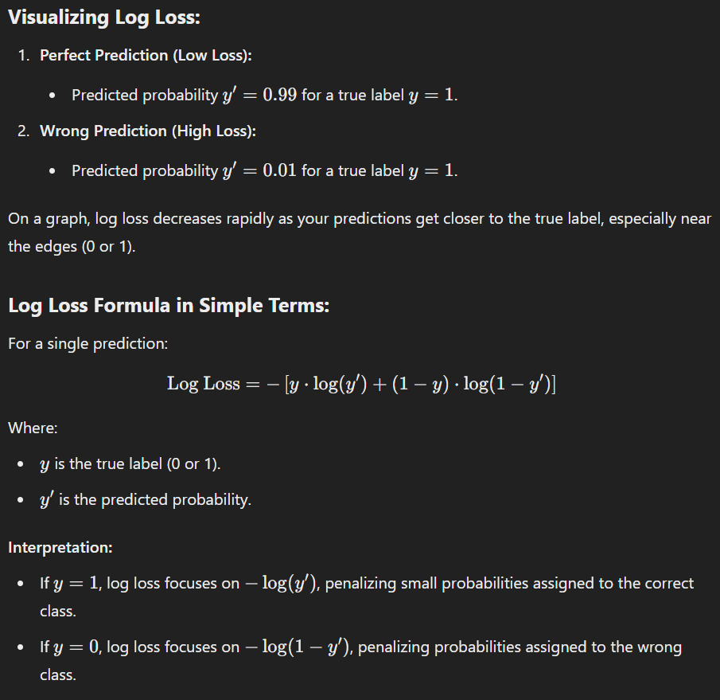

Slide 31
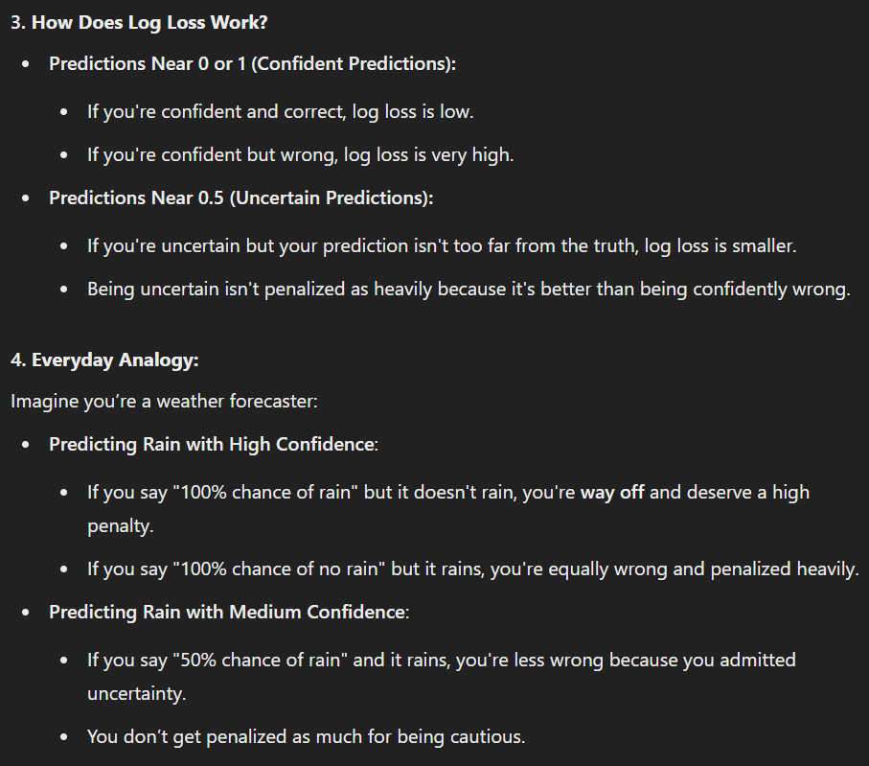

Slide 32
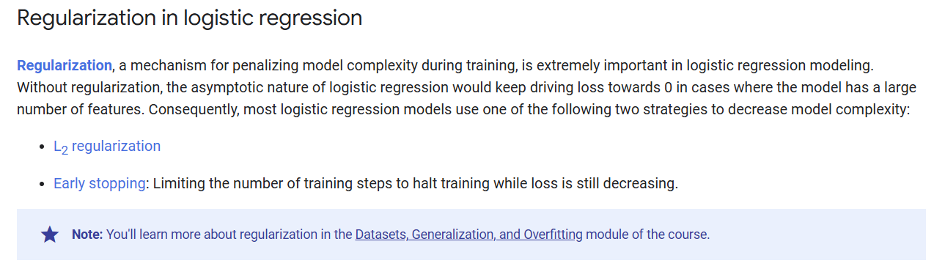

Slide 34
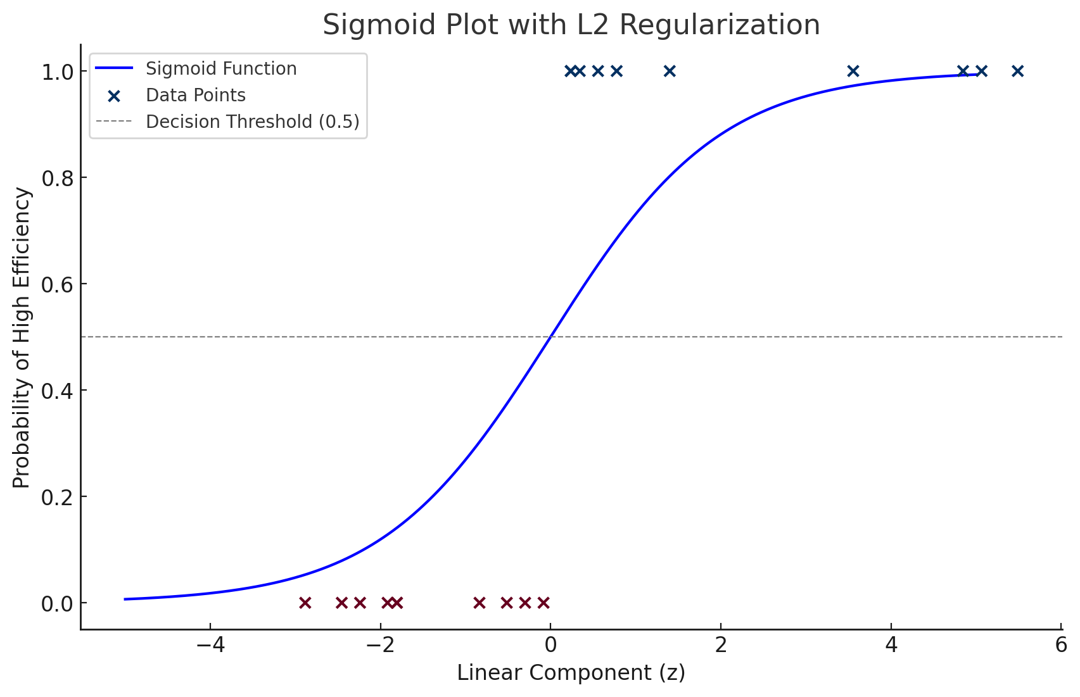

Slide 35
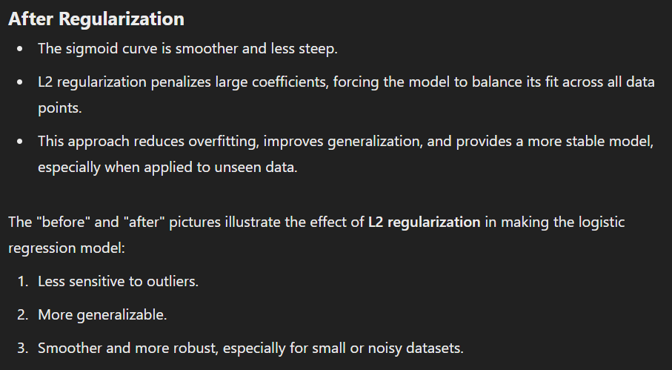

Slide 36
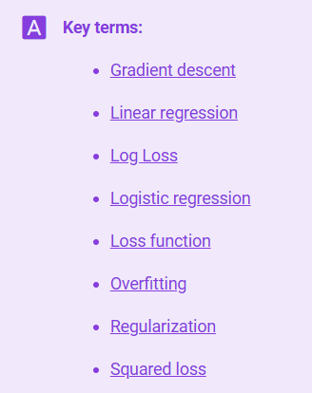
Notes:
https://developers.google.com/machine-learning/glossary

Slide 37


Slide 38
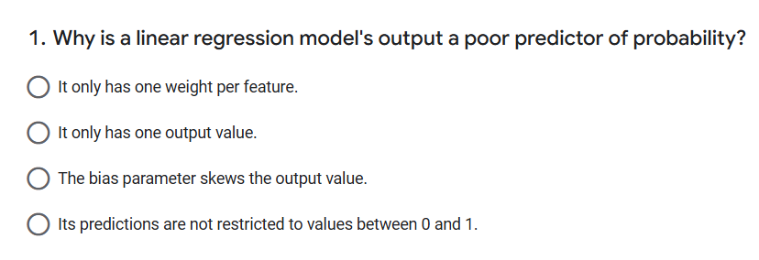

Slide 39
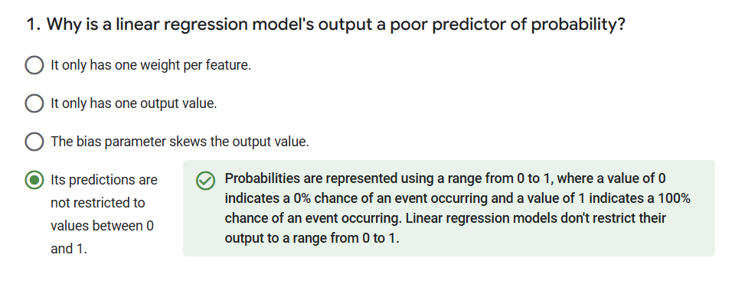

Slide 40
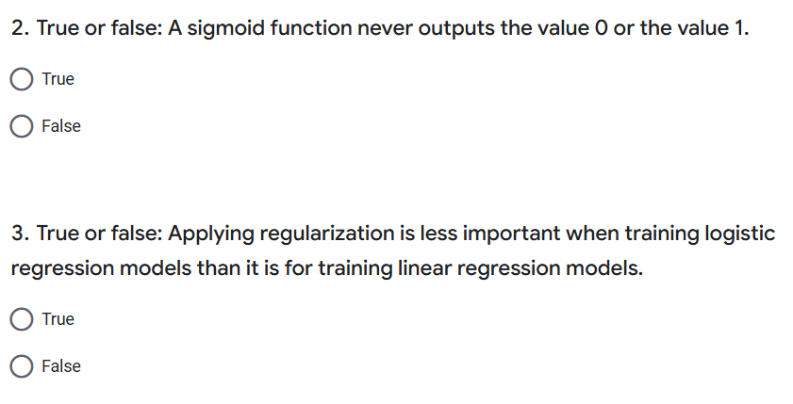

Slide 41
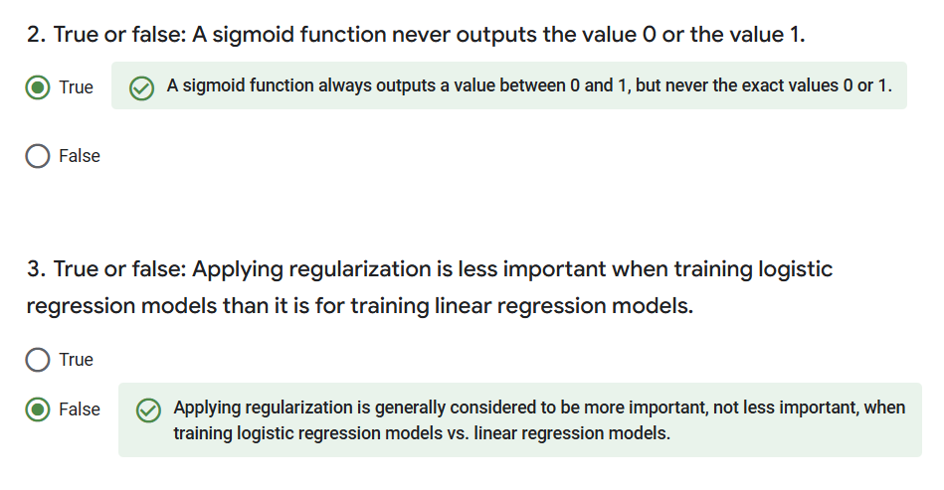

Slide 42
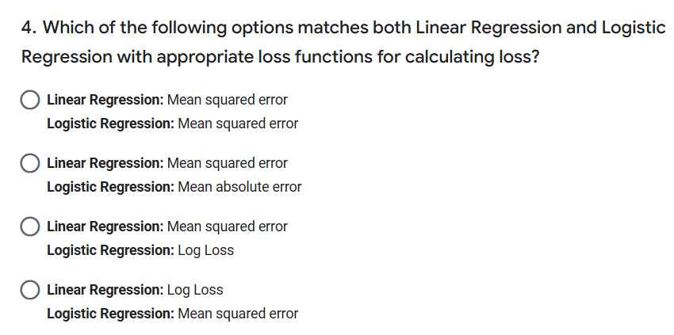

Slide 43
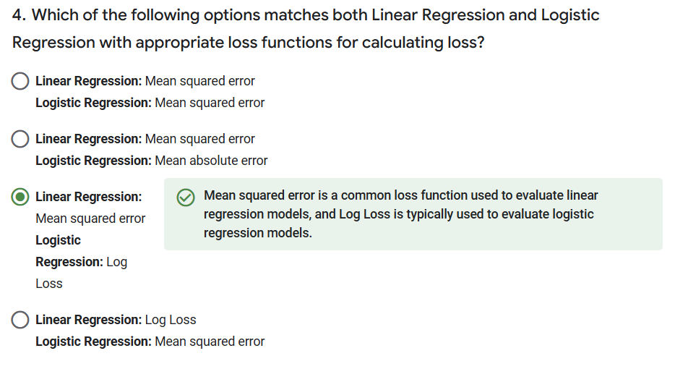

Slide 44
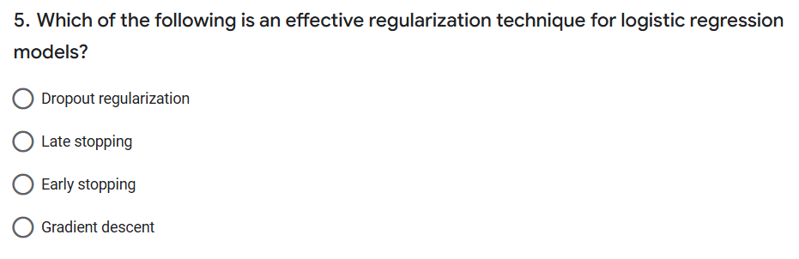

Slide 45
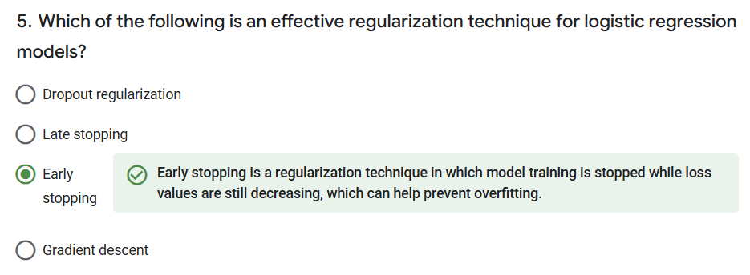

Slide 46


